Slide 1
Week 2: Debugging Help
Welcome Question – What is your favorite outdoor activity?
Start asking as soon as you are settled, remember to introduce yourself / names. By the time class starts – you should be able to list some of the activities of those people sitting around you!

Slide 2
Warm Up Problem
A farmer with a pet fox goes to the market and buys, a bag of grain and a chicken.
On the way, home she comes to a river, and a boat where she can only put one in at a time.
HOWEVER:
If left alone, the chicken will eat the bag of grain
If left alone, the fox will eat the chicken.
Think-pair-share
How can she get all three items over the river, without loosing any
She has to use the boat, and she has to row it – so what she doesn’t take is alone on the rivers edge.
Part 1: Think About it
Part 2: with a partner(s) attempt to solve it
Part 3: write it down – in a step, by step series of instructions others can follow!
Part 4: share with the class different ideas

Slide 3
Farmer Solution
Row the boat with chicken across the river
Take chicken out of boat and set on bank
Row the boat back
Put the fox in the boat
Row the boat with fox across the river
Take the fox out of the boat
Put the chicken in the boat
Row the boat back with chicken across the river
Take chicken out of boat
Put the grain in the boat
Row the boat with grain across the river
Take the grain out of the boat
Row the boat back
Put chicken in the boat
Row the boat with chicken across river
Take chicken out of boat
Return home with grain, chicken, fox
17-21 steps! (maybe some for farmer)

Slide 4

What is Computer Science? (Discussion)

Slide 5
What is Computer Science?
I daresay you haven’t had much practice,” said the Queen. “When I was your age, I always did it for half-an-hour a day. Why, sometimes I’ve believed as many as six impossible things before breakfast.”
Alice in Wonderland
Computer Science is…
Solving real world problems using technology as our means to solve them.
Corollary: Computer Sciences seek to improve the world around them by attempting to solve some of the world’s unsolvable problems.
HOMEWORK (ok, suggestion): Spend the next week,
documenting things you think would be better,
and that how many computers could improve them
Come with at least six ”problems/opportunities” that you would like to see improved to next week

Slide 6
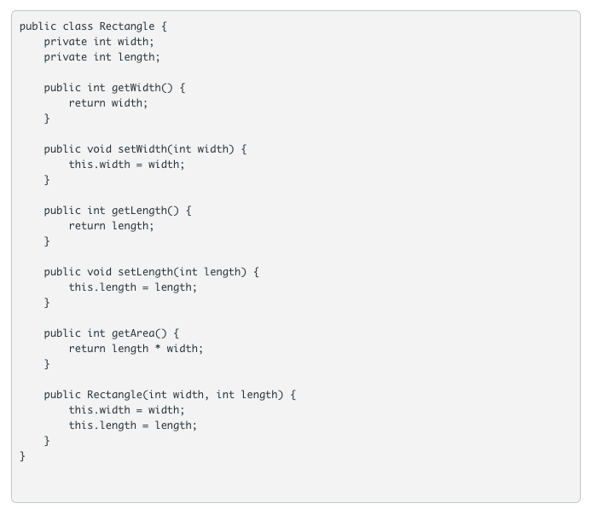
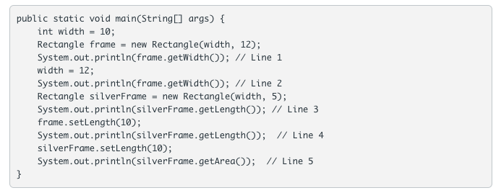
Knowledge Check: Working Together

Slide 7
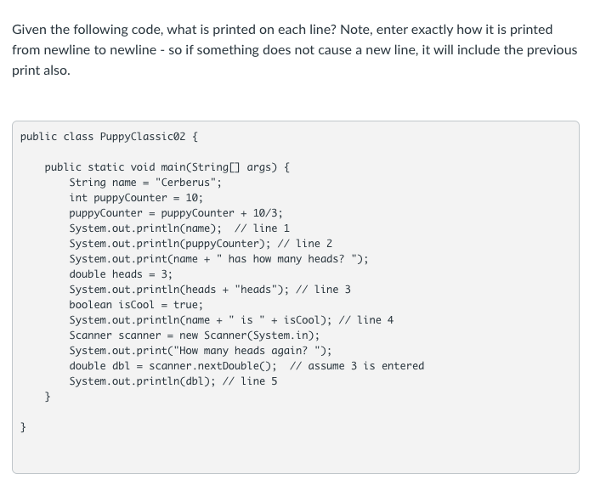
Knowledge Check: Working Together
Notes:
TAs – remember, System.in triggers a new line as they are typing first!
Line 1: Cerberus
Line 2: 13
Line 3: Cerberus has how many heads? 3.0heads
Line 4: Cerberus is true
Line 5: 3.0
(note the last one – feel free to run this one in a *terminal*, if you get a lot of questions)

Slide 8
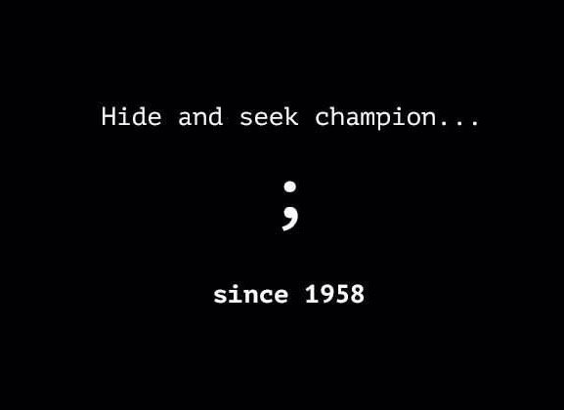
Debugging Code
Code in zybooks – to follow along with!
Compile Errors
bad syntax
missing semicolon (bane of all coders)
missing curly brackets
Runtime Errors
Crashes while running
Logic Errors
Poor logic
Works, but not as intended
Solution
code only a few lines at a time
run after a few lines
even if running doesn’t do much!
Methods help you group code
Debug and test methods as you write
Let’s look at some examples

